Slide 1





Spectral unmixing in Chemometrics
Workshop
DENNIS SEMYALO
Dept. Smart Agricultural Systems, Chungnam Natl. University
December 5, 2024

Slide 2
Overview
Introduction
Spectral unmixing technique
Applications of spectral unmixing in chemometrics
Spectral unmixing hands-on tutorial in Python
Conclusions
References

Slide 3
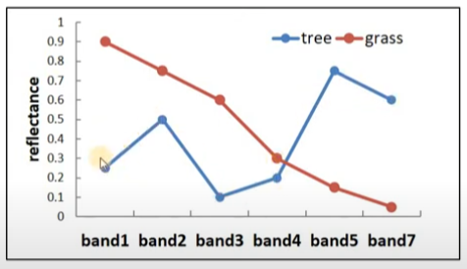
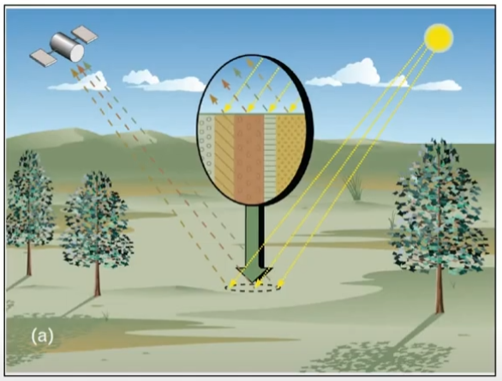
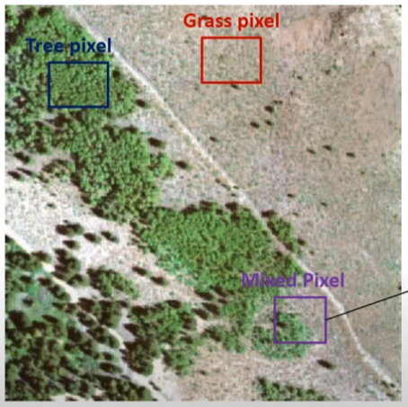
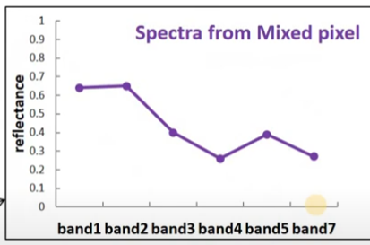
Introduction
Spectral unmixing separates pure spectral signatures of constituents and their distribution in mixture measurements/samples.
Useful in remote sensing, chemometrics, & environmental data applications
Remote sensing
Spectral unmixing
Common terms - synonyms
Pure components/ pure analytes/pure constituents
Pure spectral signatures/endmembers/ constituent spectra/ spectra profile
Concentration/fractions of endmembers/abundances/ distribution profile

Slide 4
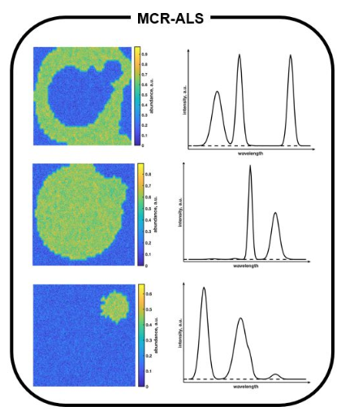
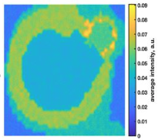
Introduction
Chemometrics
Application in chemometrics includes the use of spectroscopy, & hyperspectral imaging on chemical mixture samples
Applicable on variety of spectroscopies such as infrared, ultraviolet-visible (UV-Vis), near-infrared (NIR), mass spectrometry, etc.
Spectral unmixing decomposes hyperspectral images into distribution maps and spectral profiles associated with all the constituents in the samples (Badaró et al., 2021; De Juan et al., 2014).
Pure component spectra and distribution maps by spectral unmixing of simulated hyperspectral image

Slide 5


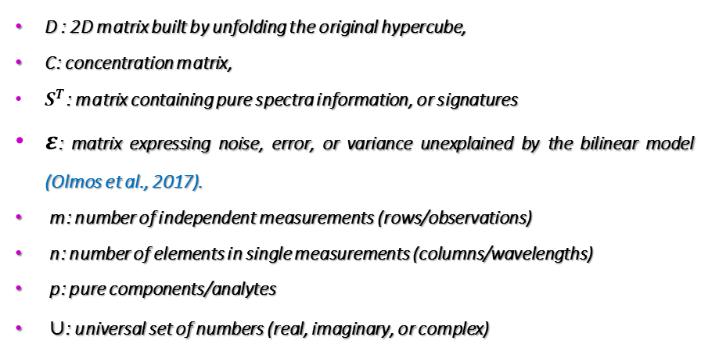





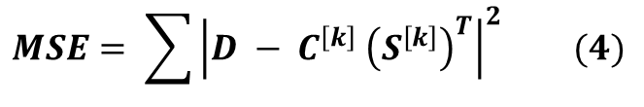
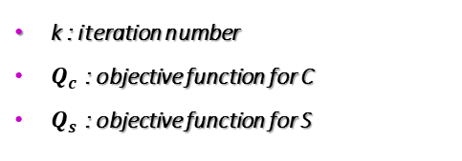
Spectral unmixing technique
Algorithm: Multivariate Curve Resolution Alternating Regression(MCR-AR)
MCR also known as self-modeling mixture analysis (SMMA) enables spectral unmixing in chemometrics
Mathematically, MCR methods are based on a bilinear model
Eq. (1) solved using an iterative alternating regression (AR) scheme; fix C, calculate S, and vice versa
Regressors include OLS (MCR-ALS), NNLS (MCR-NNLS), Lasso (MCR-Lasso), Ridge (MCR-Ridge), etc.
$$D =CS^{T} +ε (1)$$
$C^{\left[k+1\right]}=argmin Q_{c}\left(C^{\left[k\right]},S^{\left[k\right]}\right) \left(2\right)$
|
$$D ε ∪^{m,n}$$
|
$$C ε ∪^{m,p}$$
|
$$S ε ∪^{n,p}$$
|
$$ε ε ∪^{m,n}$$
|
$$C^{\left[k\right]}$$
D : 2D matrix built by unfolding the original hypercube,
C: concentration matrix,
$S^{T}$: matrix containing pure spectra information, or signatures
$ε$: matrix expressing noise, error, or variance unexplained by the bilinear model (Olmos et al., 2017).
m: number of independent measurements (rows/observations)
n: number of elements in single measurements (columns/wavelengths)
p: pure components/analytes
$∪$: universal set of numbers (real, imaginary, or complex)
$S^{\left[k+1\right]}=argmin Q_{s}\left(C^{\left[k+1\right]},S^{\left[k\right]}\right) \left(3\right)$
$$S^{\left[k\right]}$$
$$MSE= \sum{{\left|D − C^{\left[k\right]} {\left(S^{\left[k\right]}\right)}^{T}\right|}^{2} (4)}$$
k : iteration number
$Q_{c}$ : objective function for C
$Q_{s}$ : objective function for S

Slide 6
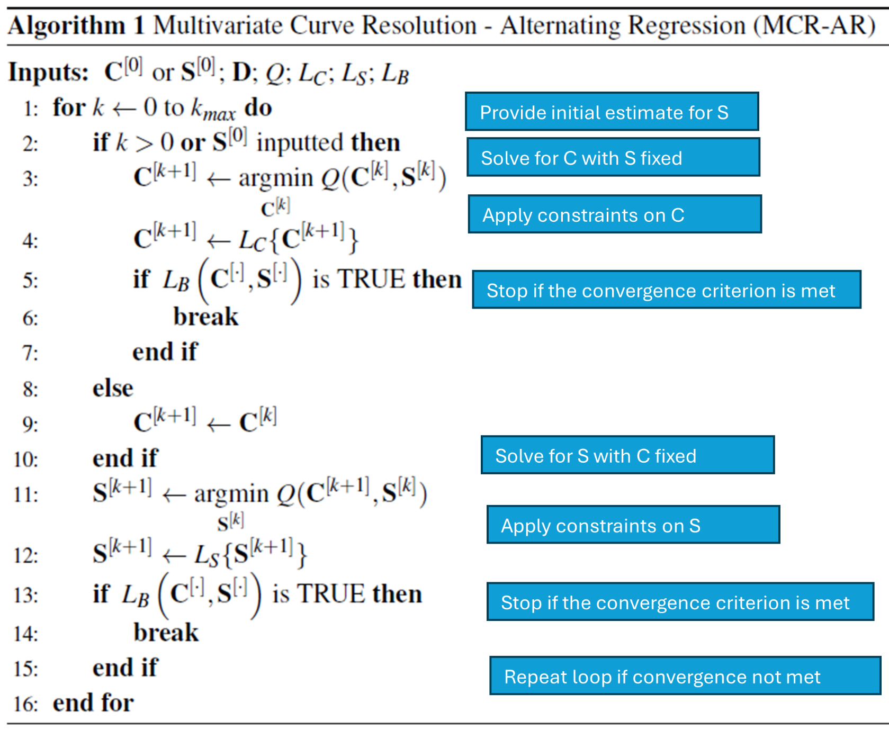
Spectral unmixing technique
Algorithm: Multivariate Curve Resolution Alternating Regression(MCR-AR)
D: input data matrix
S: pure spectral profile
C: pure concentration profile
S^{[0]}: initial estimate for S
C^{[0]}: initial estimate for C
k: iteration number
Q: objective function for S & C
LS: constraint applied to S
L_{C}: constraint applied to C
L_{B}: convergence criterion
convergence criterion
Number of iterations meets preset maximum
Error function (e.g. MSE) exceeds a defined value
Relative change of MSE after each iteration
Etc.

Slide 7
Applications of spectral unmixing in chemometrics
Purpose | source
Detection of adulterants (starch, urea, and melamine) in milk powder | (Forchetti & Poppi, 2017)
Fiber distribution in pasta | (Badaró et al., 2021)
Study of vegetal tissues (Lignins, Vesicles, and chlorophylls) in rice leaves | (Gómez-Sánchez et al., 2021)
Analysis of the constituents (sucrose, lactose, butter, and whey ) of commercial chocolate samples | (Zhang et al., 2015)
Evaluate glucosinolate level to detect postharvest senescence in broccoli | (Guo et al., 2022)
Detection of blood in fish muscle | (Skjelvareid et al., 2017)
Distribution of tissue cryosections of the zebrafish head, including eyes, brain, and mouth | (Olmos et al., 2017)
Some studies used spectral unmixing for feature extraction purposes (Guo et al., 2022).

Slide 8
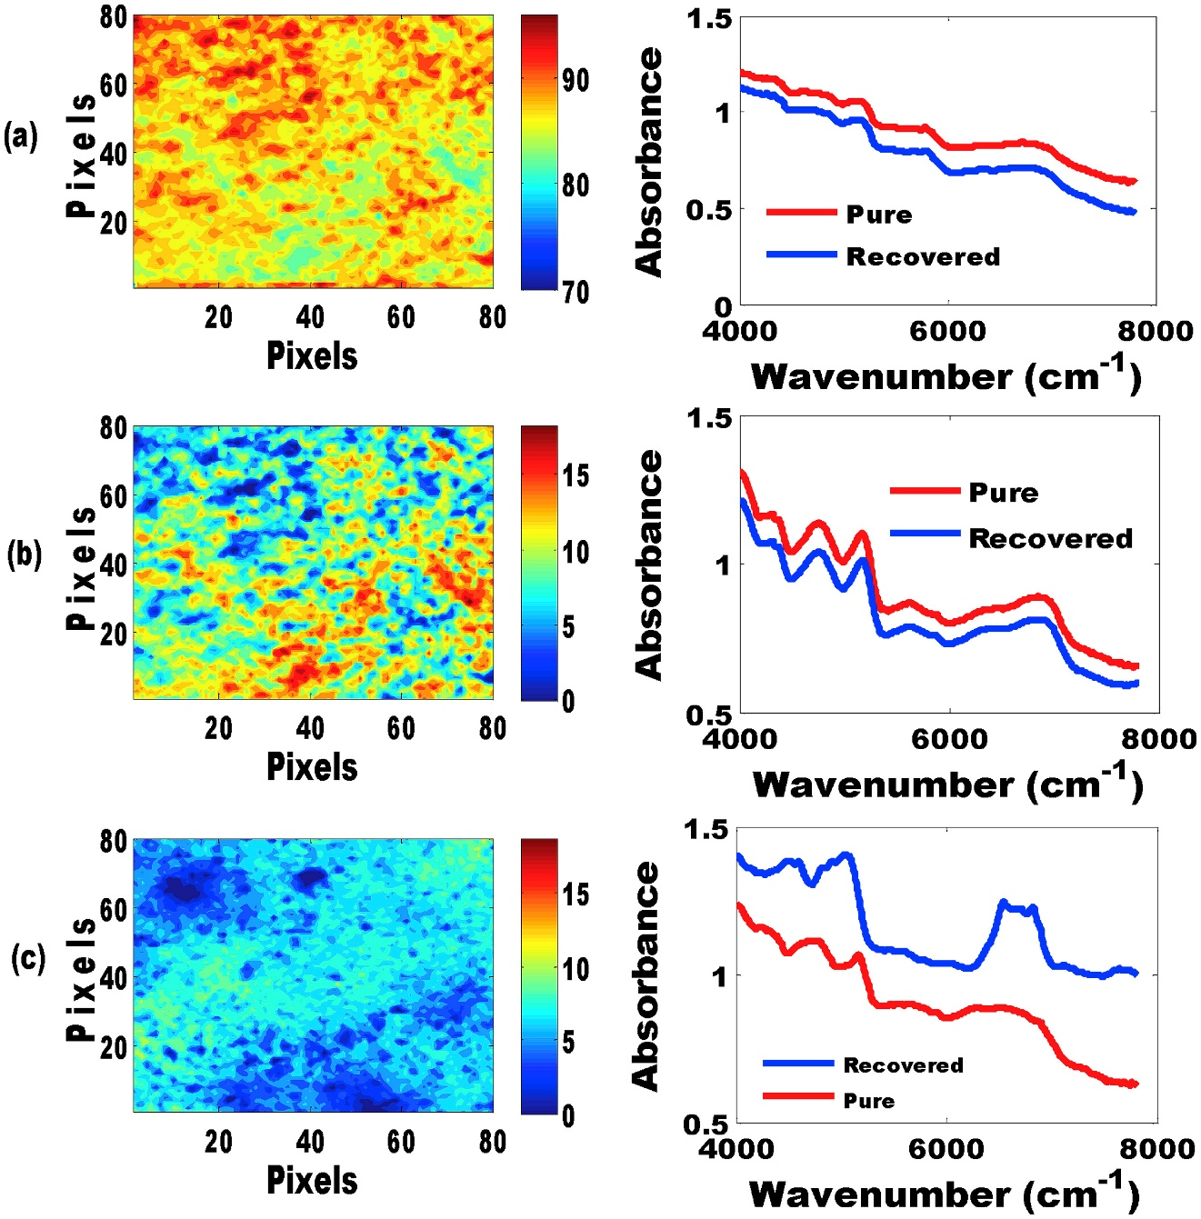
Applications of spectral unmixing in chemometrics
Detection of adulterants (starch, urea, and melamine) in milk powder (Forchetti & Poppi, 2017) : NIR-HSI
(a) milk powder
(b) starch
(c) urea
Distribution maps
Expected and recovered by MCR spectra

Slide 9
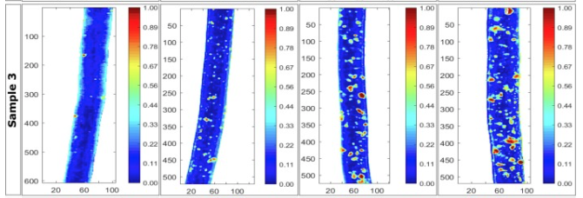
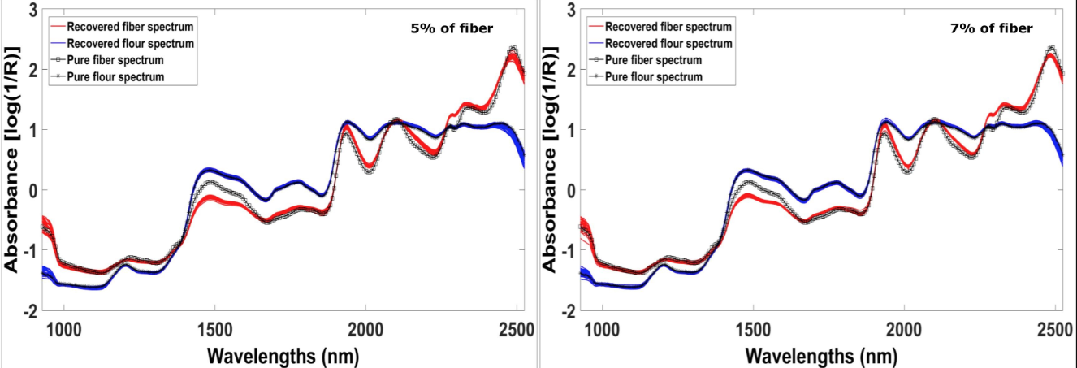
Applications of spectral unmixing in chemometrics
Fiber distribution in pasta (Badaró et al., 2021): NIR-HSI
Pure and recovered spectra from fiber and flour
Concentration map

Slide 10
Spectral unmixing hands-on tutorial in Python
Developed software program for spectral unmixing based on pyMCR, an open-source Python library
Open-source software library
Setup and installations
Install additional libraries (Dependencies)
python >= 3.4 up to 3.9
pip install numpy
pip install pyMCR
pip install scipy
Or pip3 install pyMCR
pip install matplotlib
Verify Installation
import pymcr
print(pymcr.__version__)

Slide 11
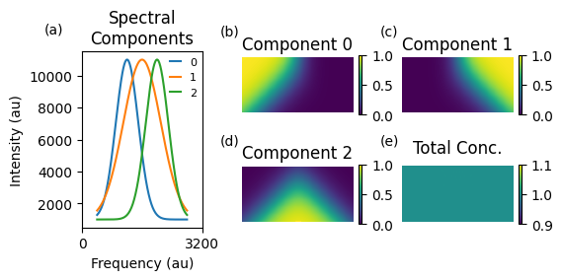
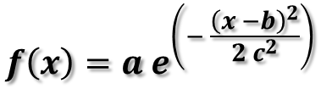
Spectral unmixing hands-on tutorial in Python
Simulated HSI dataset
a : amplitude (height of the peak)
b : center position of the peak
c : standard deviation
Spectra with 3 unique components and concentration maps simulated using Gaussian waveform and functions.
Spectra and concentration maps are combined to form a hyperspectral image (HSI)
HSI image unfolded into a data matrix, D
Spectral unmixing performed with MCR-ALS and MCR-NNLS
$$f\left(x\right)=a e^{\left(− \frac{{\left(x −b\right)}^{2}}{2 c^{2}}\right)}$$
Simulated dataset with 3 unique components with their corresponding concentration maps

Slide 12
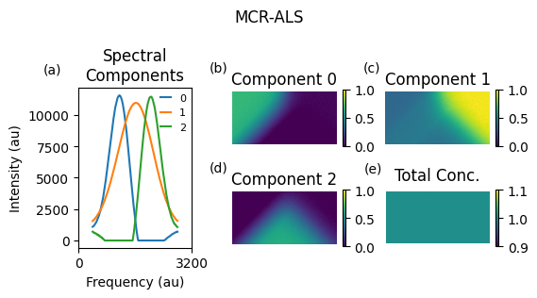
Spectral unmixing hands-on tutorial in Python
MCR-ALS results
Retrieved results using spectral unmixing with MCR-ALS

Slide 13
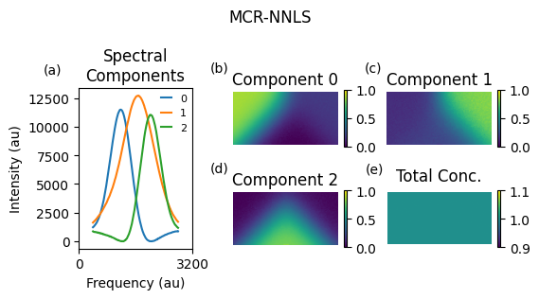
Spectral unmixing hands-on tutorial in Python
MCR-NNLS results
Retrieved results using spectral unmixing with MCR-NNLS

Slide 14
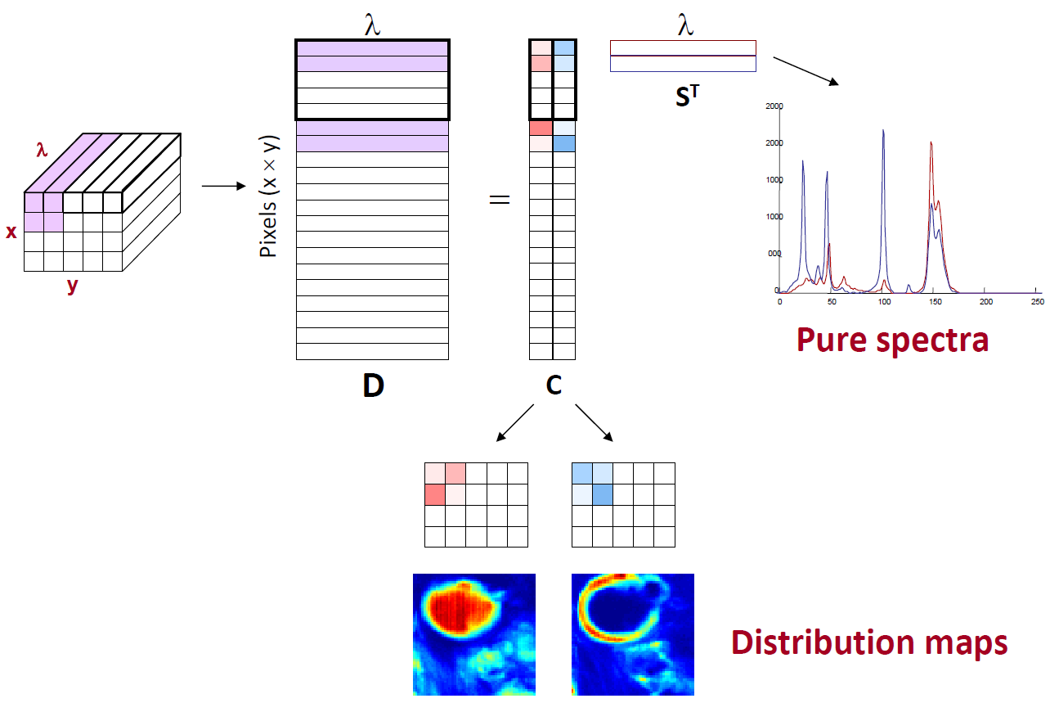
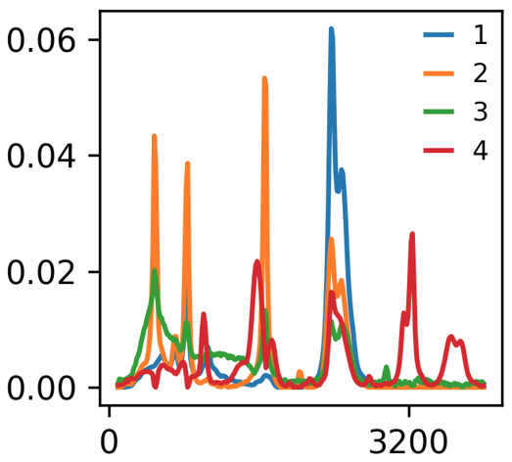
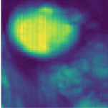
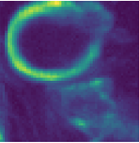
Spectral unmixing hands-on tutorial in Python
Spectral unmixing of an oil emulsion
Downloaded hyperspectral Raman image of an oil emulsion, sized (60 x 60 x 253).
Oil emulsion is a mixture of oil, water, and an emulsifying agent
Hypercube unfolded into a data matrix, D
Performed spectral unmixing using a custom-developed software program in Python
Number of components (4)
Initial estimates of spectral profile determined using SIMPLISMA, a pure variable selection method.
Constraints: non-negativity on C and S matrix
Used 1000 iterations during optimization

Slide 15
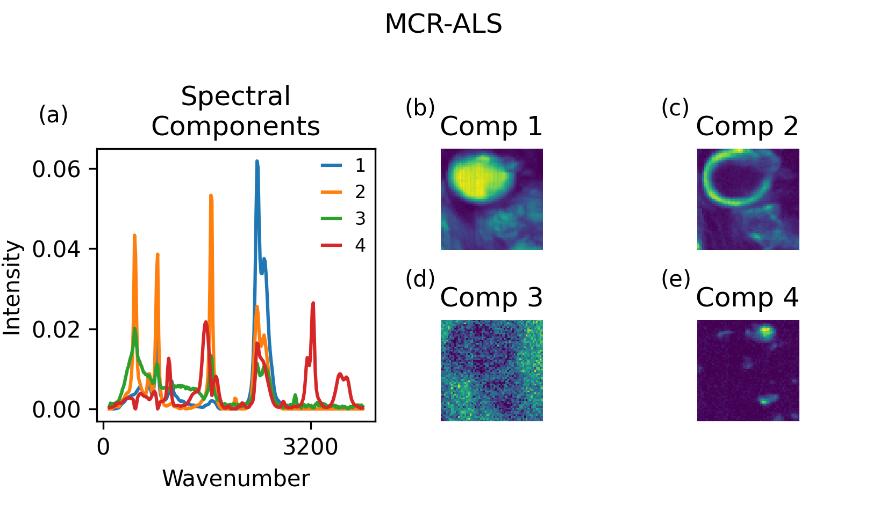
Spectral unmixing hands-on tutorial in Python
MCR-ALS results
Pure spectra and distribution maps reflect the surface pattern of an emulsion
An oily phase represented by two components (a big drop and the interface around), the outer aqueous phase and a small patch, which is an emulsion additive.
Retrieved results using spectral unmixing with MCR-ALS

Slide 16

Spectral unmixing hands-on tutorial in Python
MCR-NNLS results
Retrieved results using spectral unmixing with MCR-NNLS

Slide 17
Conclusions
Spectral unmixing is effective in chemometrics for mixing problems
Hands-on practice for spectral unmixing in python was explored
Research opportunities using spectral unmixing in chemometrics still available
Flexibility during implementation of multivariate curve resolution alternating regression (MCR-AR) such as various regressors, and constraints can be applied during the optimization process
With this introduction and hands-on workshop, this approach can be adapted to participants’ research
Looking forward to various collaborations on spectral unmixing

Slide 18
Thank You

Slide 19
References
Badaró, A. T., Amigo, J. M., Blasco, J., Aleixos, N., Ferreira, A. R., Clerici, M. T. P. S., & Barbin, D. F. (2021). Near infrared hyperspectral imaging and spectral unmixing methods for evaluation of fiber distribution in enriched pasta. Food Chemistry, 343, 128517. https://doi.org/https://doi.org/10.1016/j.foodchem.2020.128517
De Juan, A., Jaumot, J., & Tauler, R. (2014). Multivariate Curve Resolution (MCR). Solving the mixture analysis problem. Analytical Methods, 6(14), 4964–4976. https://doi.org/10.1039/C4AY00571F
Olmos, V., Benítez, L., Marro, M., Loza-Alvarez, P., Piña, B., Tauler, R., & de Juan, A. (2017). Relevant aspects of unmixing/resolution analysis for the interpretation of biological vibrational hyperspectral images. TrAC Trends in Analytical Chemistry, 94, 130–140. https://doi.org/https://doi.org/10.1016/j.trac.2017.07.004

Slide 20
References
Guo, X., Ahlawat, Y. K., Liu, T., & Zare, A. (2022). Evaluation of postharvest senescence of Broccoli via hyperspectral imaging. Plant Phenomics. https://doi.org/10.34133/2022/9761095
Forchetti, D. A. P., & Poppi, R. J. (2017). Use of NIR hyperspectral imaging and multivariate curve resolution (MCR) for detection and quantification of adulterants in milk powder. LWT - Food Science and Technology, 76, 337–343. https://doi.org/https://doi.org/10.1016/j.lwt.2016.06.046

